Slide 1

SciSheets Design Overview
J Hellerstein
February 14, 2017

Slide 2
Agenda
Focus on hierarchical tables UI.
UI essentials
Class structure
Code structure
Formulas will be a separate discussion.

Slide 3
UI Essentials

Slide 4
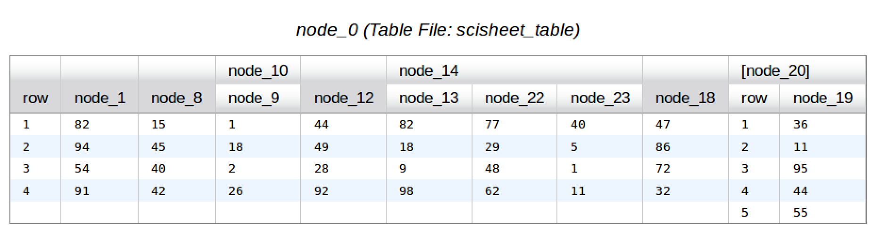
UI Essentials
Cell: Container of a data object
Column: Collection of one or more cells
Table: Collection of columns and tables
  Columns of a table have the same number of cells
  Attached (sub) tables have columns with the same number of cells
Row: cells at the same position in a table (and its attached subtables)
Sheet: Container of tables and columns

Slide 5
UI Essentials
Column header
Sheet caption
Table header
Row for outer-most Table
Row for table node_20
cell
Every collection of attached tables has a "name column" called "row"

Slide 6
Popup Menus
Each UI element has its popup menus accessed by a left click
  Sheet: caption
  Table: Table header
  Column: Column header
  Row: cell in "row" column
  Cell: cell (brings up edit menu)

Slide 7
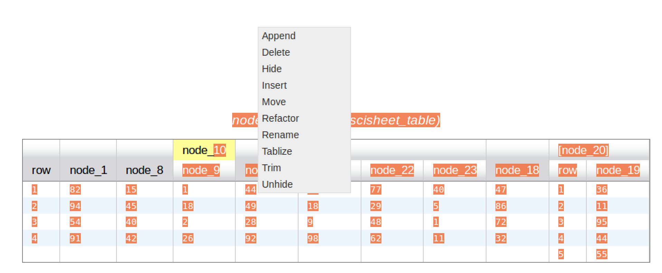
Example of a pop-up menu - Table
Clicking on the header causes it to be highlighted and brings up the menu.

Slide 8
Class Structure

Slide 9
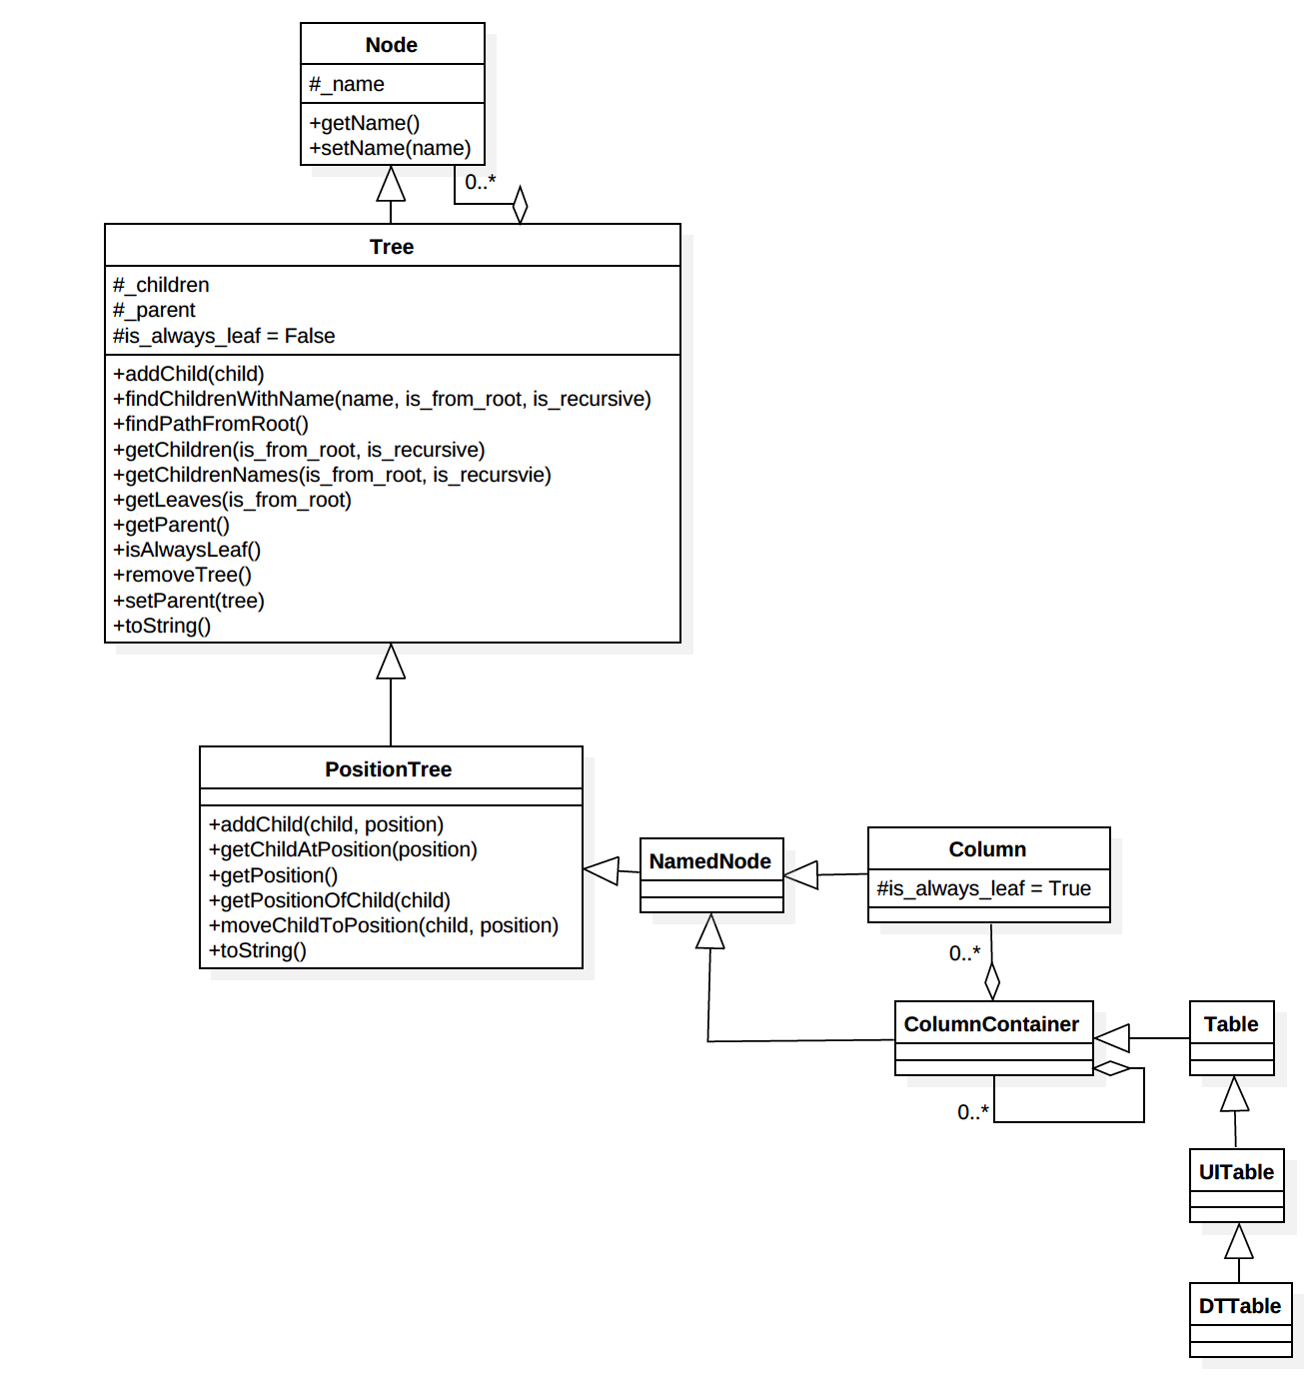
Relates names of nodes (Table, Column) to position in the Tree implied by a hierarchical table.
Knows about data in a collection of Cells.
Knows about rows and name columns
Manipulates Trees.
Manages a collection of columns.
Manages the positions of nodes relative to their parent.
Process UI Commands
"Renders" sheets for JavaScript

Slide 10
Code Structure

Slide 11
JavaScript Directories
mysite
mysite
static
scitable – js for UI
js_test – tests for UI
templates
scitable.html – base template
scitable_data.html – template for data

Slide 12
Common Directories
mysite
mysite
url.py – map URL to python code
settings.py – parameterization of Appl
helpers
tree.py – Node, Tree, PositionTree
named_tree.py - NamedTree

Slide 13
SciSheets Directories
mysite
scisheets
views.py – where URLs are mapped
helpers
scisheets_views.py – URL processing
ui
ui_table.py – UITable
dt_table.py – DTTable
core
table.py – Table
column_container.py – ColumnContainer
column.py - Column

